Slide 1
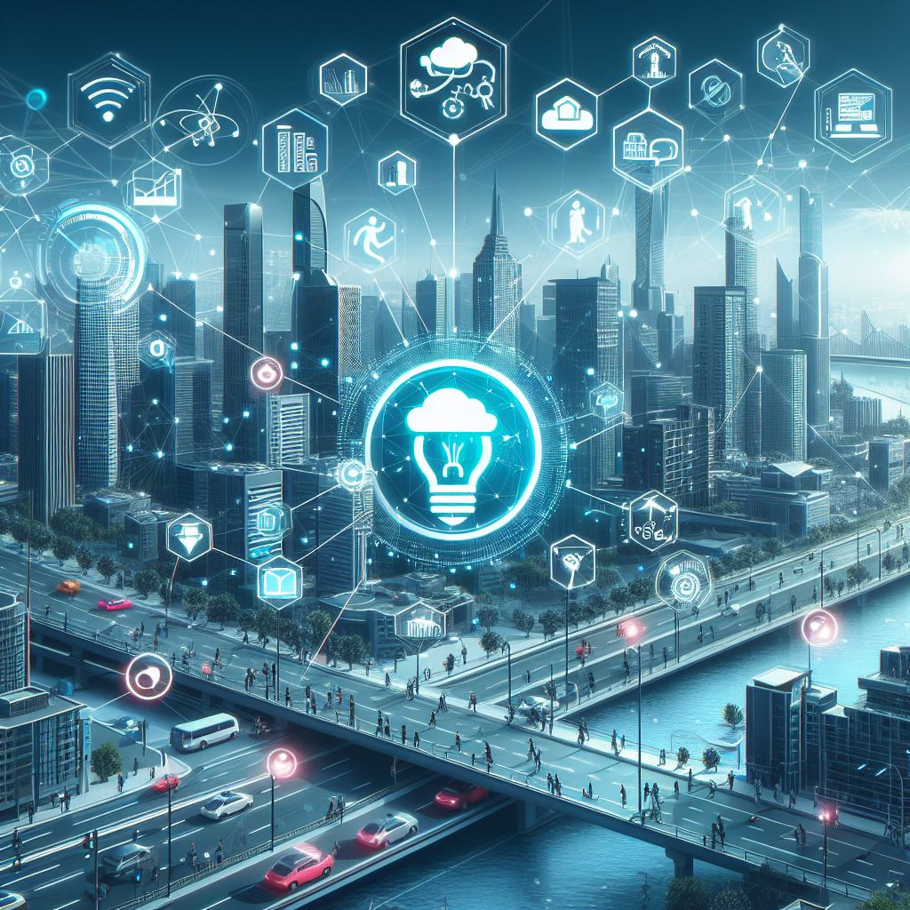
IoT and Machine
Learning for the Monitoring and Management of Smart Places
Addressing Key Research Questions and Challenges
Nikolaos Thomas
May 2024

Slide 2
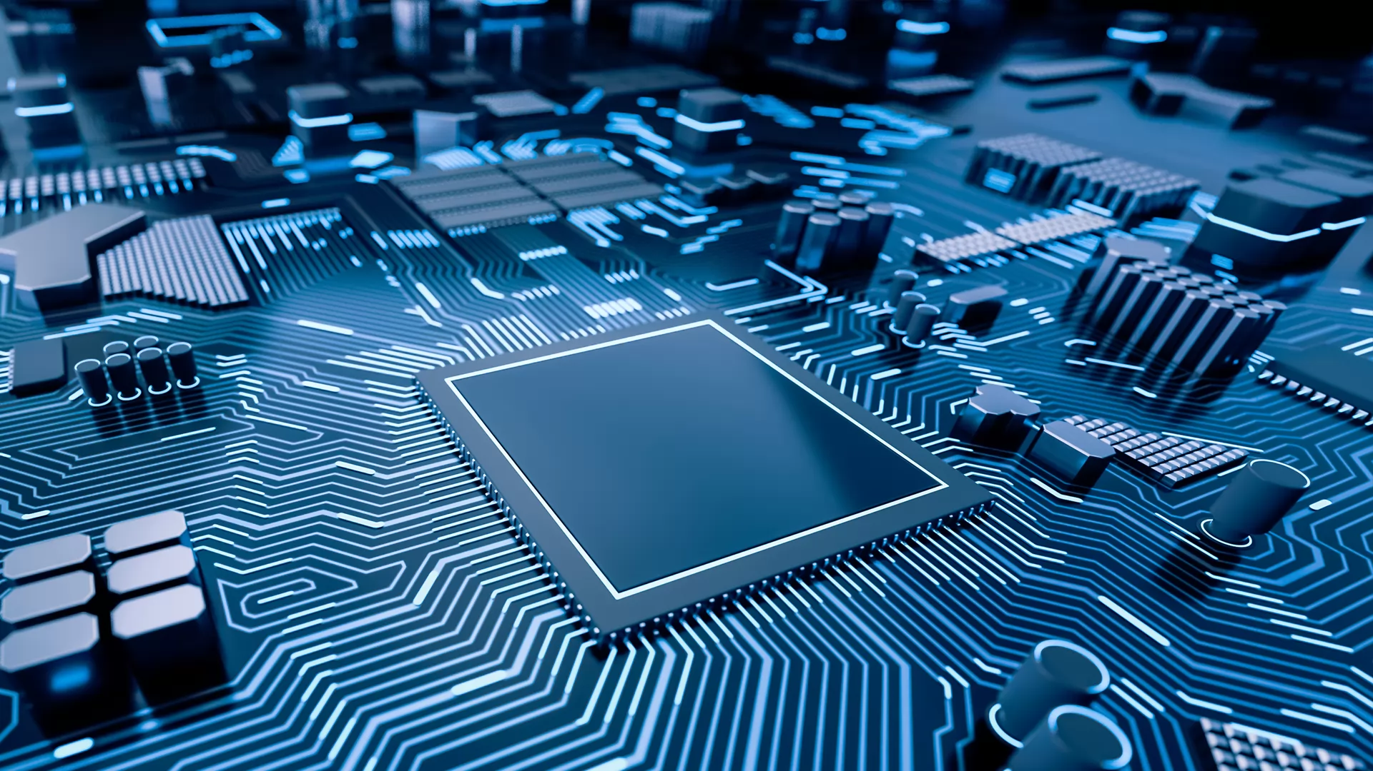
Introduction
Smart cities are rapidly emerging as the future of urban development, leveraging cutting-edge technologies to enhance efficiency, sustainability, and quality of life for residents. Central to the concept of smart cities is the integration of Internet of Things (IoT) and Machine Learning (ML) technologies, enabling real-time monitoring, analysis, and management of various aspects of urban environments.
In this presentation, we delve into the integration of IoT and ML for smart city management, addressing key research questions and challenges in this dynamic field. By exploring the intersection of these technologies, we aim to uncover insights that can inform the design, implementation, and optimization of smart city initiatives worldwide.

Slide 3
Abstract
To guide our exploration of IoT and ML integration in smart city management, we address six fundamental research questions:
How can machine learning algorithms be optimized and integrated into IoT systems for real-time monitoring and management of smart cities?
What are the most effective sensor configurations and data collection strategies for IoT-based monitoring of various aspects of smart places (e.g., traffic, air quality, energy consumption)?
How can machine learning algorithms leverage IoT data to predict and prevent failures in critical infrastructure systems within smart places?
What are the privacy and security challenges associated with deploying IoT devices in smart places, and how can machine learning techniques mitigate these risks?
How can reinforcement learning techniques be employed to optimize resource allocation and decision-making in smart places based on IoT-generated data?
What role can edge computing play in enhancing the efficiency and effectiveness of IoT and machine learning systems for monitoring and managing smart places?
By addressing these questions, we aim to gain comprehensive insights into the opportunities, challenges, and future directions of IoT and ML integration in smart city management.

Slide 4
Literature Review
Our investigation draws upon a diverse range of literature sources to inform our understanding of IoT and ML integration in smart city management. Some key papers we have reviewed include:
"Machine Learning and Deep Learning Algorithms for Smart Cities: A Start-of-the-Art Review" by Oladipo et al.
"Smart Prediction and Monitoring of Waste Disposal System Using IoT and Cloud for IoT-Based Smart Cities" by John et al.
"Cloud Failure Prediction Based on Traditional Machine Learning and Deep Learning" by Asmawi et al.
"IoT Privacy and Security: Challenges and Solutions" by Tawalbeh et al.
"Deep Reinforcement Learning for Resource Allocation in Business Processes" by Żbikowski et al.
"Edge Computing in IoT: Enhancing Efficiency and Performance" by Kulkarni.
These papers provide valuable insights into various aspects of IoT and ML integration in smart city management, including optimization techniques, sensor configurations, predictive maintenance strategies, privacy and security considerations, and the role of edge computing.

Slide 5
Method
Our methodology encompasses several key steps to address the research questions and objectives outlined in this study:
Literature Review: We conducted an extensive review of academic papers, conference proceedings, and industry reports to gather insights into the integration of IoT and ML technologies for smart city management.
Data Collection: We collected data from diverse sources, including IoT sensors, public databases, and case studies, to analyze the effectiveness of ML algorithms and sensor configurations in real-world smart city environments.
Data Analysis: Advanced data analysis techniques, such as statistical analysis, machine learning algorithms, and deep learning models, were employed to analyze the collected data and derive meaningful insights.
Case Studies: Collaborative case studies were conducted with smart city stakeholders and industry partners to validate our findings and assess the practical implications of our proposed methodologies.
Validation and Evaluation: Rigorous testing and evaluation were conducted to validate our methodology against benchmark datasets and real-world scenarios, assessing the accuracy, reliability, and scalability of our proposed solutions.
Documentation and Reporting: Finally, we documented our methodology, findings, and recommendations in a comprehensive research report, highlighting key insights, challenges, and future directions for integrating IoT and ML technologies in smart city management.
This systematic approach allowed us to address the research questions posed in this study and contribute to the advancement of knowledge in the field of smart city management.

Slide 6
Results and Discussion
Our analysis yielded several key findings and insights regarding the integration of IoT and ML technologies for smart city management:
Optimization of ML Algorithms: We identified the performance of various ML algorithms in real-time monitoring and management of smart cities, highlighting the importance of efficient data preprocessing and scalable deployment strategies.
Effective Sensor Configurations: Our study explored sensor configurations and data collection strategies for IoT-based monitoring of smart places, emphasizing predictive maintenance and timely data collection.
Predictive Maintenance Strategies: ML algorithms were found to be effective in predicting and preventing failures in critical infrastructure systems within smart places, enabling proactive maintenance and reducing downtime.
Privacy and Security Challenges: We addressed privacy and security concerns associated with deploying IoT devices in smart places, proposing ML techniques to mitigate these risks and foster trust among stakeholders.
Reinforcement Learning Applications: Our investigation revealed the potential of reinforcement learning techniques in optimizing resource allocation and decision-making based on IoT-generated data, enhancing efficiency and effectiveness in smart city management.
Role of Edge Computing: Finally, we discussed the role of edge computing in enhancing the efficiency and effectiveness of IoT and ML systems for monitoring and managing smart places, emphasizing reduced latency, bandwidth savings, and enhanced privacy.
These findings provide valuable insights into the opportunities and challenges of integrating IoT and ML technologies for smarter and more sustainable urban environments.

Slide 7
Future Research Directions
Looking ahead, several promising avenues for future research in the field of IoT and ML for smart city management include:
Federated Learning Approaches: Exploring collaborative model training across distributed sensors to improve model robustness and generalization.
Explainable AI Models: Developing interpretable ML models to enhance transparency and accountability in decision-making processes.
Edge AI Ecosystems: Advancing tools and frameworks tailored for edge computing environments to optimize resource allocation and improve scalability.
Ethical Considerations: Addressing biases and fairness in ML models, as well as ensuring user rights and privacy protections in smart city deployments.
By focusing on these research directions, we can further advance the integration of IoT and ML technologies for smarter, more sustainable, and equitable urban environments.

Slide 8
Conclusion
In conclusion, the integration of Internet of Things (IoT) and Machine Learning (ML) technologies holds immense potential for revolutionizing the monitoring and management of smart cities. Through our comprehensive analysis and exploration of key research questions, we have uncovered valuable insights into optimizing ML algorithms, effective sensor configurations, predictive maintenance strategies, privacy and security challenges, reinforcement learning applications, and the role of edge computing.
Our findings underscore the importance of leveraging the synergies between IoT and ML to address the complex challenges facing modern urban environments. From optimizing resource allocation to predicting and preventing critical infrastructure failures, the integration of IoT and ML offers unprecedented opportunities to improve the sustainability, resilience, and livability of smart cities.
By continuing to innovate and collaborate across disciplines, we can unlock the full potential of IoT and ML technologies to create more sustainable, resilient, and equitable urban environments for future generations.

